Slide 1
Matrix-Profile

Slide 2
Matrix Profile
#C++
https://github.com/zpzim/SCAMP (C++/CUDA)
https://github.com/aafulei/matrix-profile-with-dtw
#Python
https://github.com/target/matrixprofile-ts
https://github.com/ZiyaoWei/pyMatrixProfile
https://github.com/jbeleno/owlpy
https://github.com/javidlakha/matrix-profile
https://github.com/jgopikrishna/MatrixProfile_Implementation
https://github.com/briamn/Profile-Matrix
https://github.com/Qinode/final-matrix-profile
#Java
https://github.com/ensozos/Matrix-Profile
#Matlab
https://github.com/mcyeh/mstamp
https://github.com/rakbarinia/AAMP-ACAMP
https://github.com/lvovl/time-series-matrix-profile
#Go
https://github.com/aouyang1/go-matrixprofile
#R
https://github.com/franzbischoff/tsmp
#CUDA
https://github.com/zpzim/STOMPSelfJoin
https://github.com/zpzim/SCAMP

Slide 3
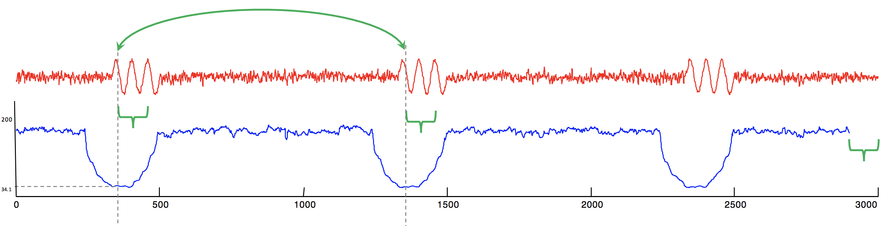
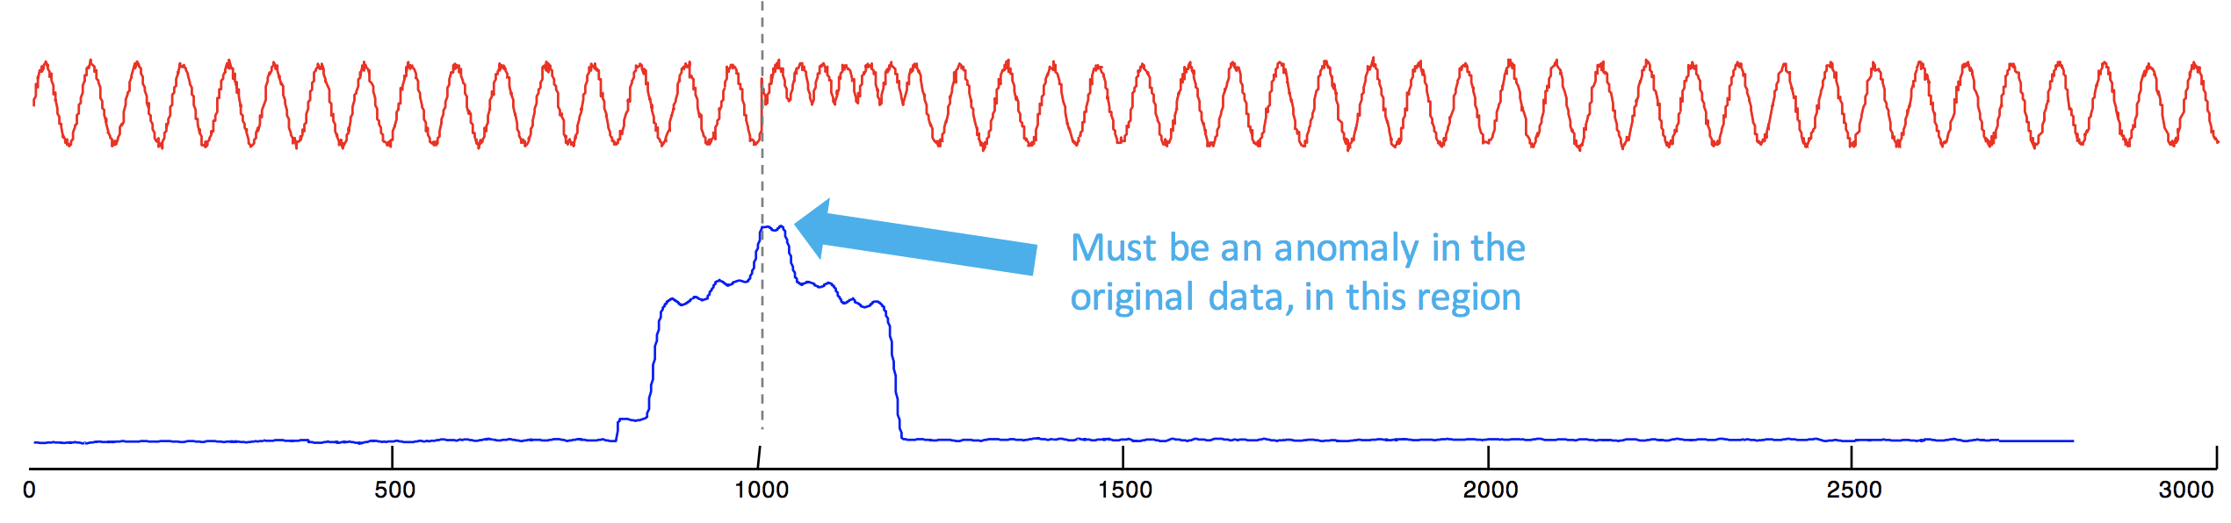
STAMP: Scalable Time Series Anytime Matrix Profile
Stamp allows us to easily compute the Matrix Profile of a time series
The Matrix Profile (MP) is a data structure that annotates a time series.
How to read Matrix Profile?
Let´s try with some synthetic data

Slide 4
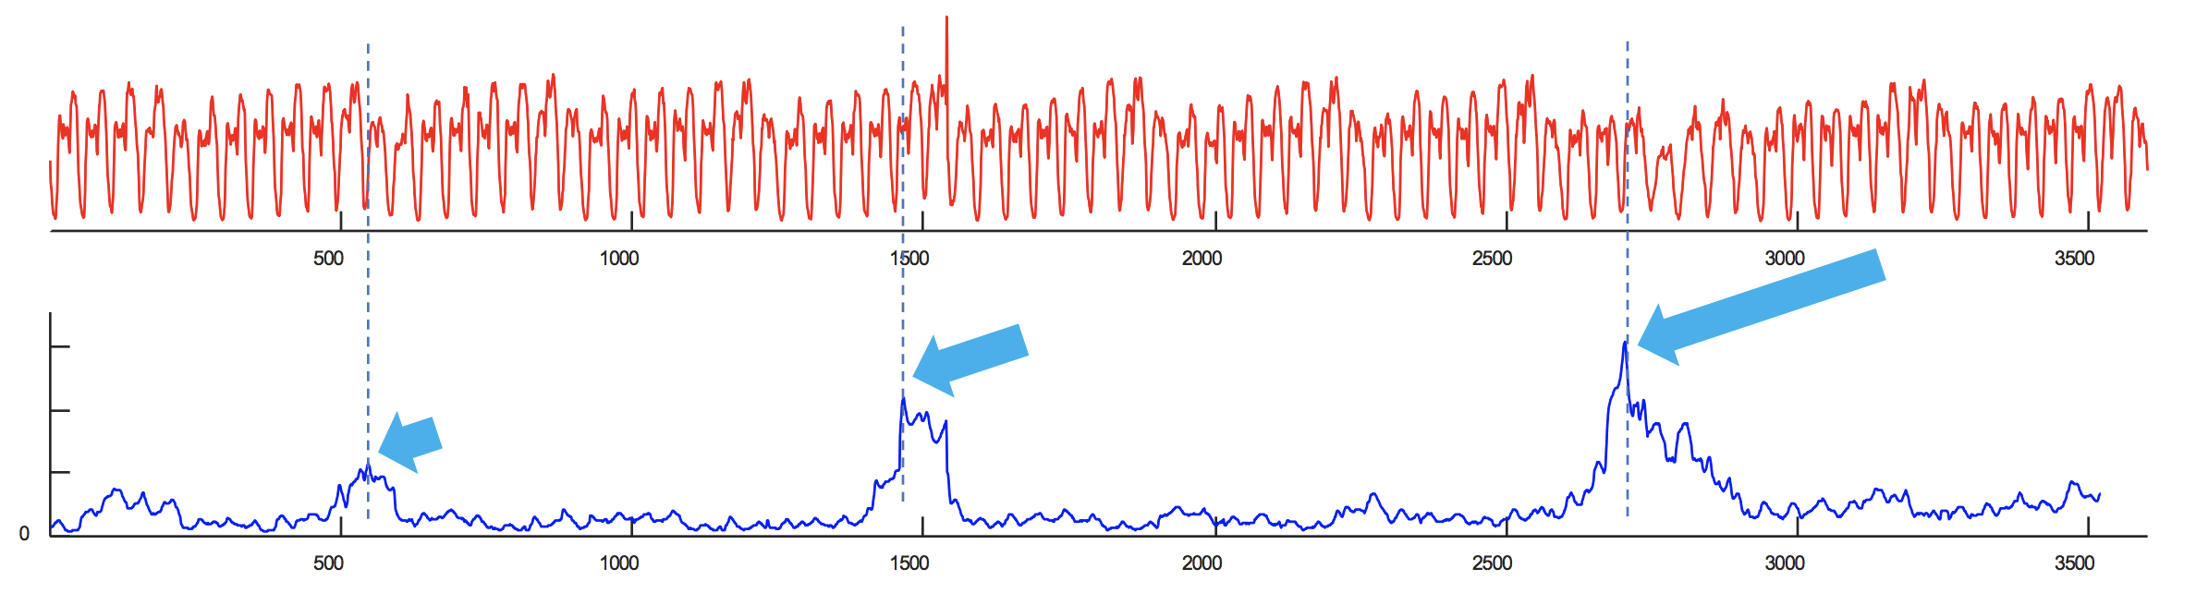
Example I:Taxi
Below is the data, the hourly average of the number of NYC taxi passengers over 75 days in Fall of 2014.
The highest value corresponds to Thanksgiving (the uniqueness of Thanksgiving was the only thing the Stanford Team noted)
We find a secondary peak around Nov 6th, what could it be? Daylight Saving Time! The clock going backwards one hour, gives an apparent doubling of taxi load.
We find a tertiary peak around Oct 13th, what could it be? Columbus Day! Columbus Day is largely ignored in much of America, but still a big deal in NY, with its large Italian American community.

Slide 5
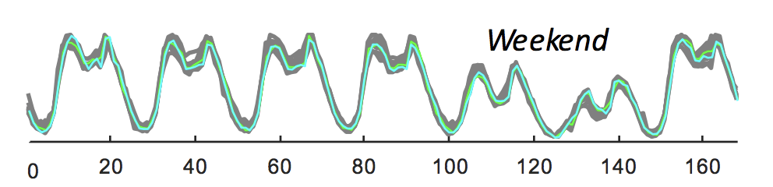
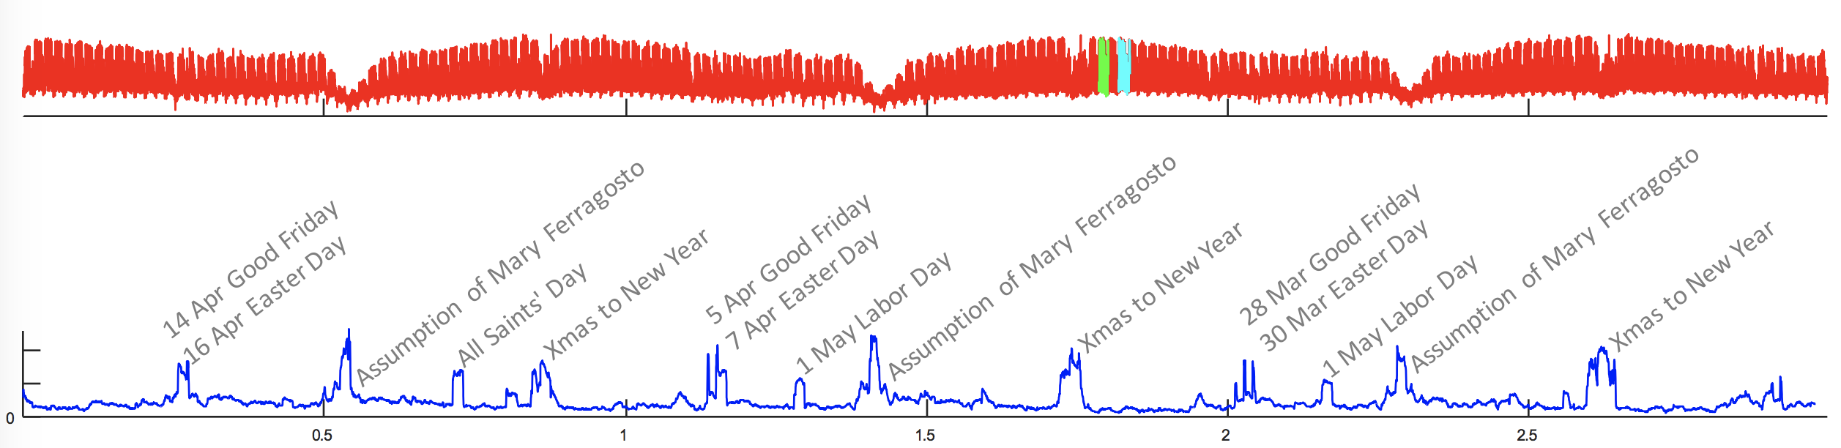
Example II: Power Demand
Note that the matrix profile is very low on average, most weeks are similar to the previous week (persistence) or the same week in a different year (history).
All the high values can be explained by Italian holidays, most of which fall on different days in consecutive years

Slide 6
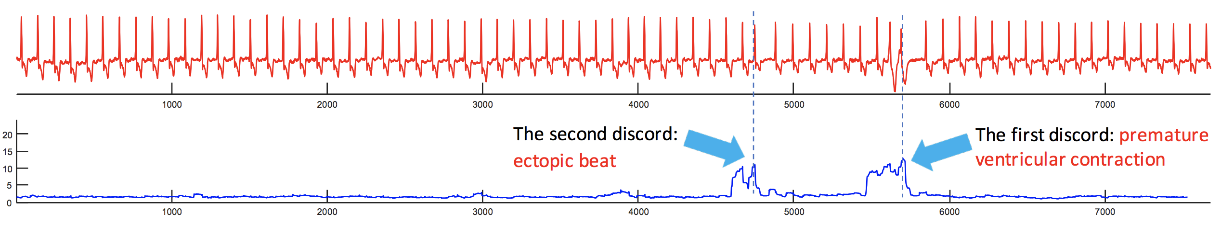
Example III: Electrocardiogram
In this case there are two anomalies annotated by MIT cardiologists.
The Matrix Profile clearly indicates them. Here the subsequence length was set to 150, but we still find these anomalies if we half or triple that length.

Slide 7
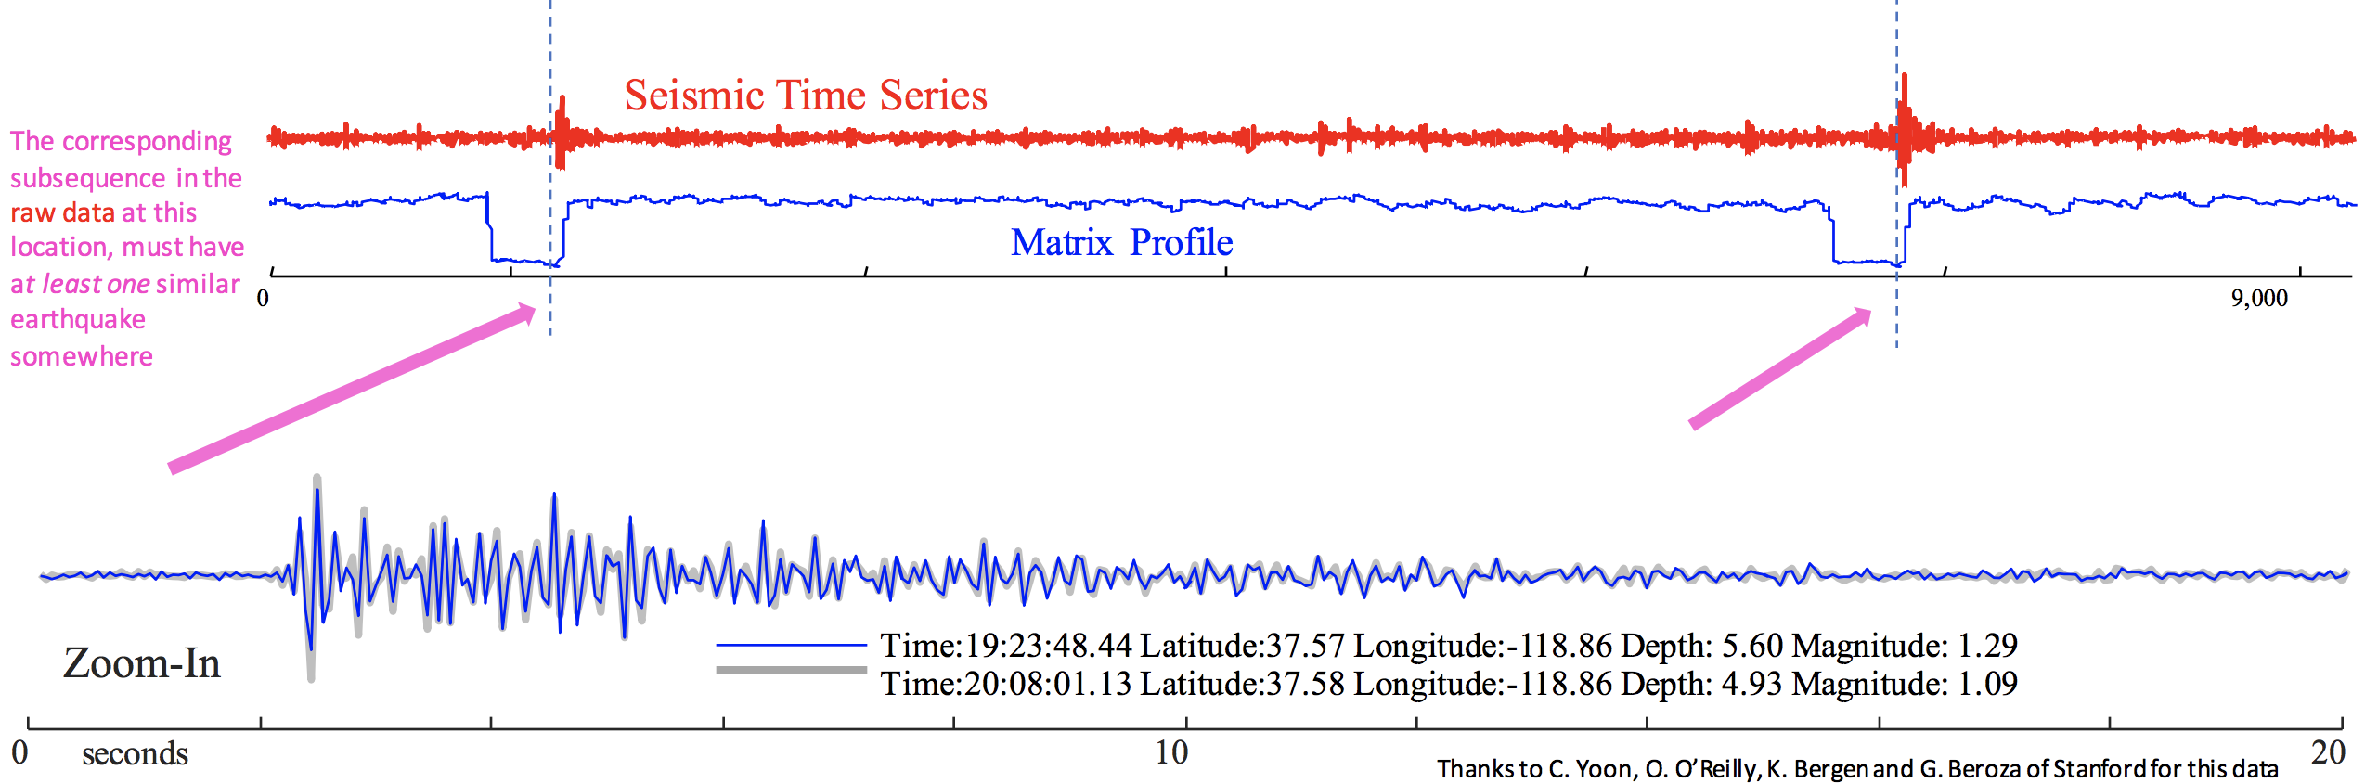
Example IV: Siesmology
If we see low values in the MP of a seismograph, it means there must have been a repeated earthquake.

Slide 8
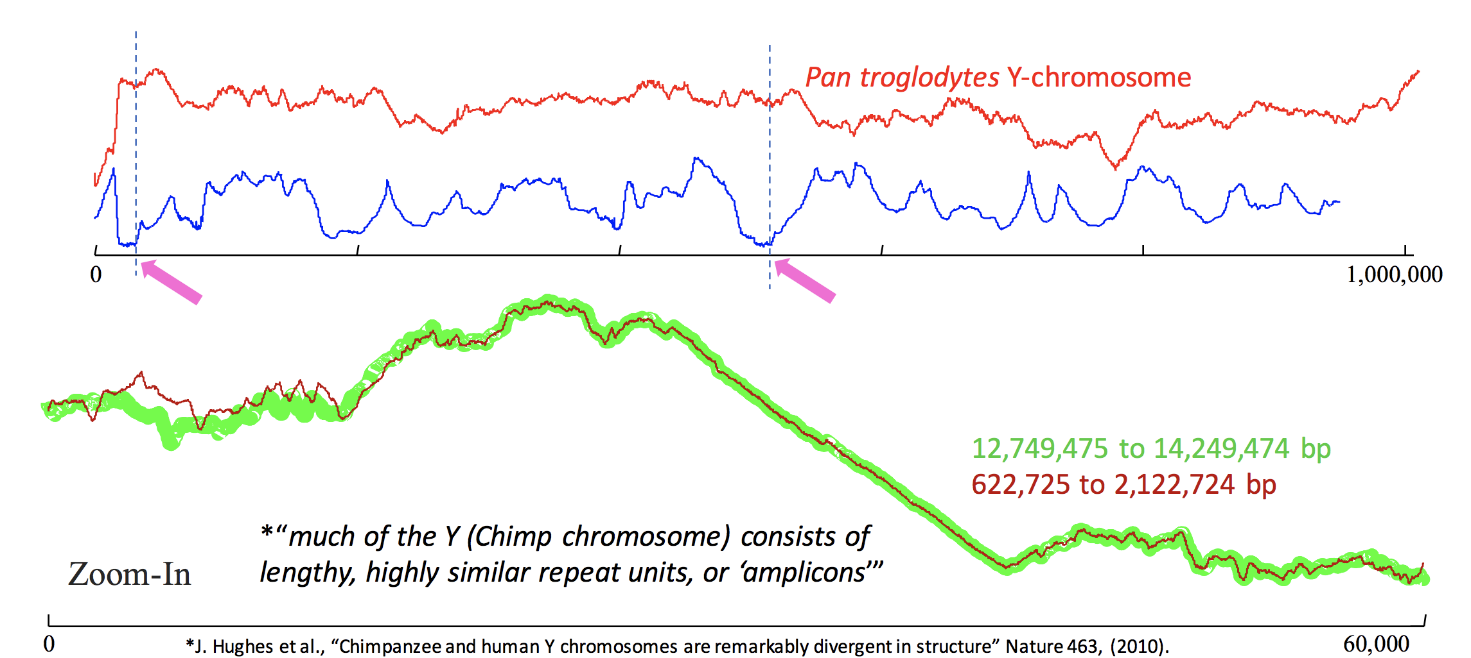
V: DNA pattern discovery
Let us search the Chimp’s DNA for repeated structure, of length 60,000…

Slide 9
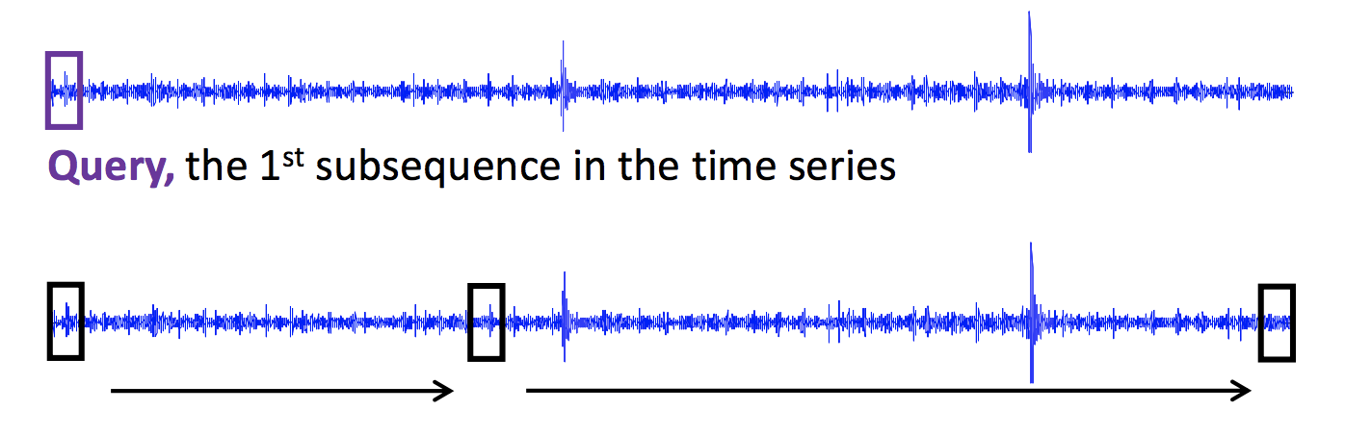
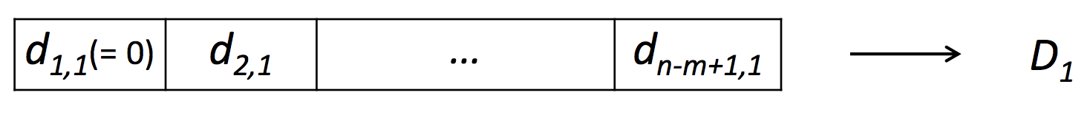
STAMP: Algorithm description
di,j is the distance between the i th subsequence and the j th subsequence. D1 We can obtain D2 , D3 , … Dn-m+1 similarly.

Slide 10
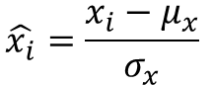
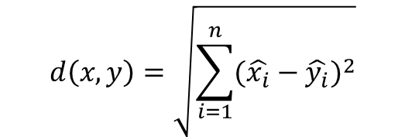
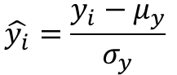
Euclidean Distance Metric
Given two time series
x = x₁…x_{n}
and
y = y₁…y_{n}
their z-Normalized Euclidean distance is defined as:
x
y
$$\hat{x_{i}}=\frac{x_{i}−μ_{x}}{σ_{x}}$$
$$\hat{y_{i}}=\frac{y_{i}−μ_{y}}{σ_{y}}$$
3
function y = zNorm(x)
y = (x-mean(x))/std(x,1);
2
1
0
$$d\left(x,y\right)=\sqrt{\sum_{i=1}^{n}{{(\hat{x_{i}}−\hat{y_{i}})}^{2}}}$$
-1
-2
0
100
200
300
400
500
600
700
800
900
1000
function d = EuclideanDistance(x,y)
d = sqrt(sum((x-y).^2));

Slide 11
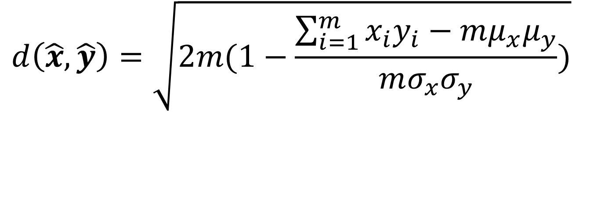
Working Formula
$$d\left(\hat{x},\hat{y}\right)=\sqrt{2m(1−\frac{\sum_{i=1}^{m}{x_{i}y_{i}−mμ_{x}μ_{y}}}{mσ_{x}σ_{y}})}$$
We will use the above z-Normalized Euclidean distance as the similarity measure for the rest of the presentation
We claim calculating Matrix Profile for Correlation Coefficient and Cosine Similarity is trivial given an algorithm for z-Normalized Euclidean distance

Slide 12
The Importance of z-Normalization and correlation 2 of 2
Without normalization, the results are very poor, some blue heartbeats are closer to red heartbeats than there are to another blue beat .
With normalization, the results are perfect.
BIDMC Congestive Heart Failure Database: chf11
1
0
-1
-2
BIDMC Congestive Heart Failure Database: chf10
-3
0
1000
Extracted beats
chf10
chf11
0
150
300
Un-normalized
Normalized
In this example, we extracted heartbeats from two different time series, and clustered them with and without normalization.
Surprisingly z-normalizing can be a computational bottleneck, but later we will show you how to fix that.

Slide 13
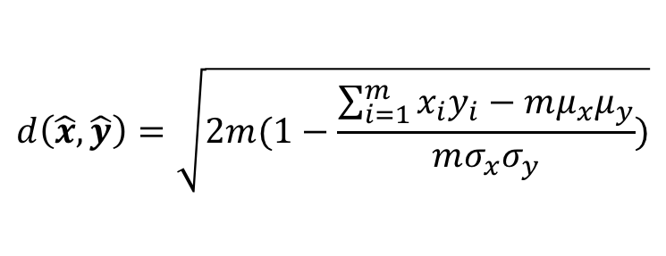
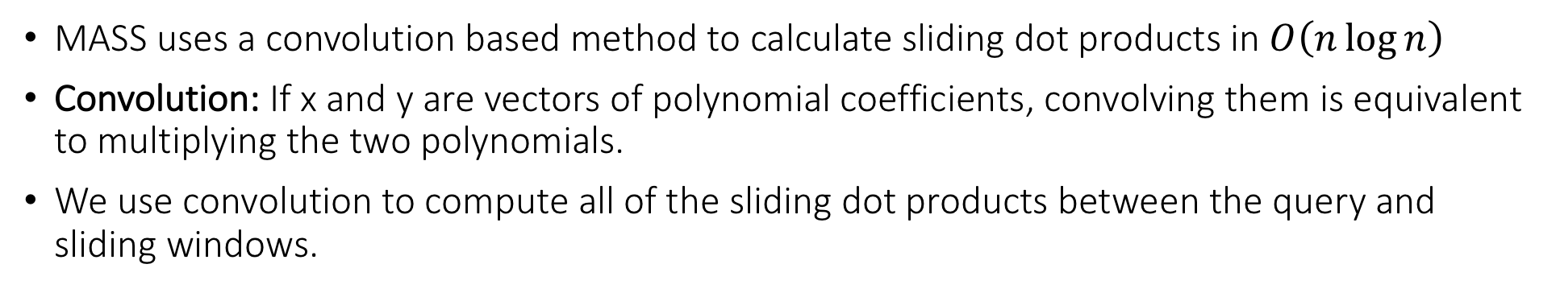
Mueen’s Algorithm for Similarity Search (MASS)
MASS uses a convolution based method to calculate sliding dot products in $O\left(n\log{n}\right)$
Convolution: If x and y are vectors of polynomial coefficients, convolving them is equivalent to multiplying the two polynomials.
We use convolution to compute all of the sliding dot products between the query and sliding windows.
$$d\left(\hat{x},\hat{y}\right)=\sqrt{2m(1−\frac{\sum_{i=1}^{m}{x_{i}y_{i}−mμ_{x}μ_{y}}}{mσ_{x}σ_{y}})}$$
Query
x₁
x₂
x₃
x₄
y₁
y₂
Input
Sliding
dot
product
y₂x₁
y₂x₂+y₁x₁
y₂x₃+y₁x₂
y₂x₄+y₁x₃
y₁x₄
0
Output

Slide 14
Mueen’s Algorithm for Similarity Search (MASS)
x₁
x₂
x₃
x₄
y₁
y₂
Input
Sliding
dot
product
y₂x₁
y₂x₂+y₁x₁
y₂x₃+y₁x₂
y₂x₄+y₁x₃
y₁x₄
0
Output
SAME AS:
x₁
x₂
x₃
x₄
y₁
y₂
Input
Time Series
Reversed and Padded Query
x₁
x₂
x₃
x₄
y₂
y₁
0
0
Convolution
y₂x₁
y₂x₂+y₁x₁
y₂x₃+y₁x₂
y₂x₄+y₁x₃
y₁x₄
0
0
Output
y₂x₂+y₁x₁
y₂x₃+y₁x₂
y₂x₄+y₁x₃

Slide 15
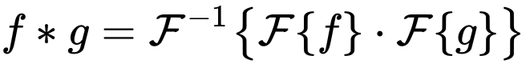
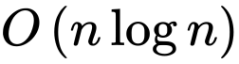
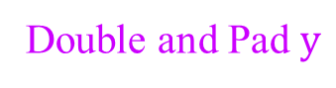
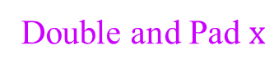
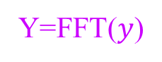
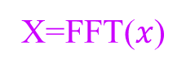
Mueen’s Algorithm for Similarity Search (MASS)
Convolution in time domain is multiplication in frequency domain.
conv(x,y) = ifft( fft( double&pad(x)) . fft(double&pad(y))
Double and Pad $x$
Double and Pad $y$
x₁
x₂
x₃
x₄
0
0
0
0
y₂
y₁
0
0
0
0
0
0
X=FFT($x$)
Y=FFT($y$)
X₁
X₂
X₃
X₄
X₅
X₄*
X₃*
X₂*
Y₁
Y₂
Y₃
Y₄
Y₅
Y₄*
Y₃*
Y₂*
X.Y
Complex
Conjugates
Y₁X₁
Y₂X₂
Y₃X₃
Y₄X₄
Y₅X₅
Y₄*X₄*
Y₃*X₃*
Y₂*X₂*
ifft(X.Y)
y₂x₁
y₂x₂+y₁x₁
y₂x₃+y₁x₂
y₂x₄+y₁x₃
y₁x₄
0
0

Slide 16
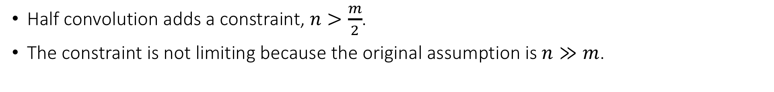
Mueen’s Algorithm for Similarity Search (MASS)
Half convolution adds a constraint, $n>\frac{m}{2}$.
The constraint is not limiting because the original assumption is $n≫m$.
x₁
x₂
x₃
x₄
y₁
y₂
x₁
x₂
x₃
x₄
y₁
y₂
Reversed and
Padded Query
Time Series
Reversed and Padded Query
Time Series
x₁
x₂
x₃
x₄
y₂
y₁
0
0
x₁
x₂
x₃
x₄
y₂
y₁
0
0
y₂x₁
y₂x₂+y₁x₁
y₂x₃+y₁x₂
y₂x₄+y₁x₃
y₁x₄
0
0
y₂x₁
y₂x₂+y₁x₁
y₂x₃+y₁x₂
y₂x₄+y₁x₃
conv(x,y) = ifft( fft( double&pad(x)) . fft(double&pad(y) )
half conv(x,y)= ifft ( fft(x) . fft(y))

Slide 17
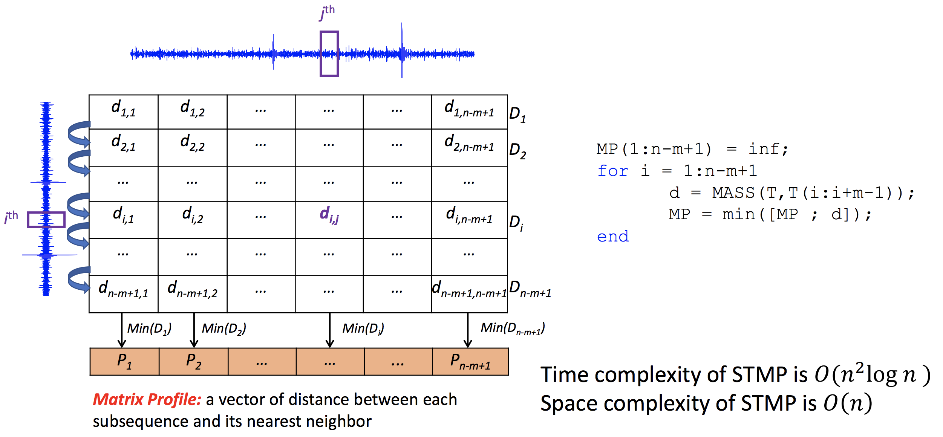
STAMP: Algorithm description (II)
d_{i,j} is the distance between the i^{th} window and the j^{th} window of the time series
Pab = np.ones(na - m) * np.inf Iab = np.zeros(na - m) idxes = np.arange(nb - m + 1) for idx in idxes: D = mass(Tb[idx: idx + m], Ta, a, meanT, sigmaT) element_wise_min(Pab, Iab, D, idx, ignore_trivial, m) return Pab, Iab

Slide 18
Trivial Match I
We need to understand the idea of a “trivial match”. It shows up for definitions of discords, motifs, similarity search etc.
Suppose we search for the query, of length 20, in the time series…
…we find its best match is at location 50…
Query Q
Time Series T
0
20
40
60
80
100
120
140
160
Best Match

Slide 19
Trivial Match II
Where is the second best match? It is probably going to be at 49 or 51, but that is trivial, it is just a minor “variant” of the original match.
(try togging backwards and forwards between this and the last slide)
Query Q
Time Series T
0
20
40
60
80
100
120
140
160
Second Best Match

Slide 20
Trivial Match III
To avoid trivial matches, we find the first match, then we set an exclusion zone around the best match, then find the second best match, etc.
The size of the exclusion zone is not critical, ½ m works well.
Query Q
Time Series T
0
20
40
60
80
100
120
140
160
Best Match
(Non-Trivial) Second Best Match

Slide 21
Trivial Match IIII Special Case
When computing the MP, we will be extracting the subsequences from the time series itself.
Clearly such queries will just find “themselves” as their own nearest neighbor!
The distance from the query to any part of the subsequence that overlaps the exclusion zone is kept undefined (NaN).
Query Q
Time Series T
0
20
40
60
80
100
120
140
160
Location Query was taken from
(Non-Trivial) Best Match

Slide 22
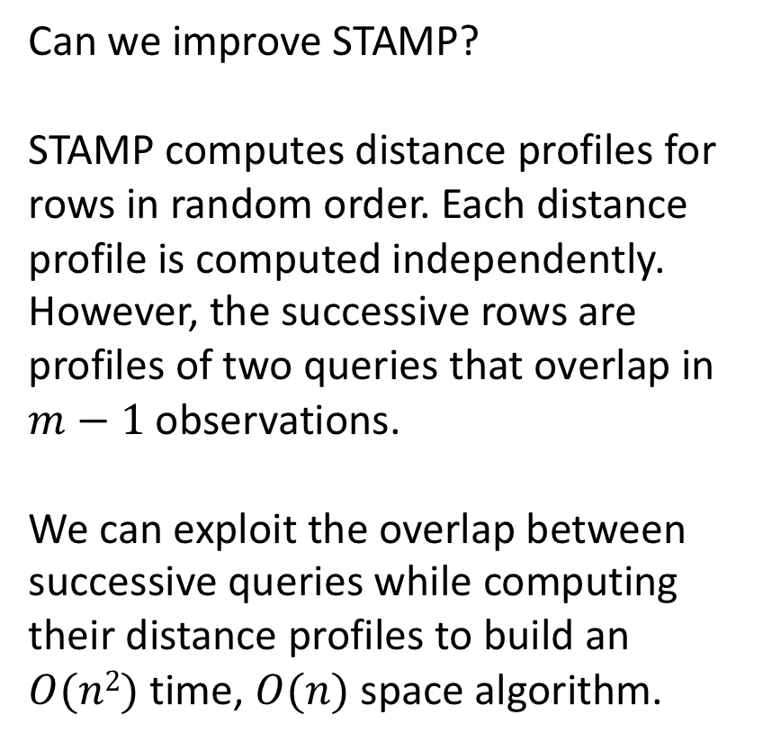
STOMP: Scalable Time series Ordered Matrix Profile
Can we improve STAMP? STAMP computes distance profiles for rows in random order. Each distance profile is computed independently. However, the successive rows are profiles of two queries that overlap in $m−1$ observations. We can exploit the overlap between successive queries while computing their distance profiles to build an $O(n2)$time, $O(n)$ space algorithm.
d_{1,1} | d_{1,2} | … | … | … | d_{1,n-m+1}
d_{2,1} | d_{2,2} | … | … | … | d_{2,n-m+1}
… | … | … | … | … | …
d_{i,1} | d_{i,2} | … | d_{i,j} | … | d_{i,n-m+1}
… | … | … | … | … | …
d_{n-m+1,1} | d_{n-m+1,2} | … | … | … | d_{n-m+1,n-m+1}
Min(D₁)
Min(D₂)
Min(D_{i})
Min(D_{n-m+1})
P₁ | P₂ | … | … | ... | P_{n-m+1}

Slide 23
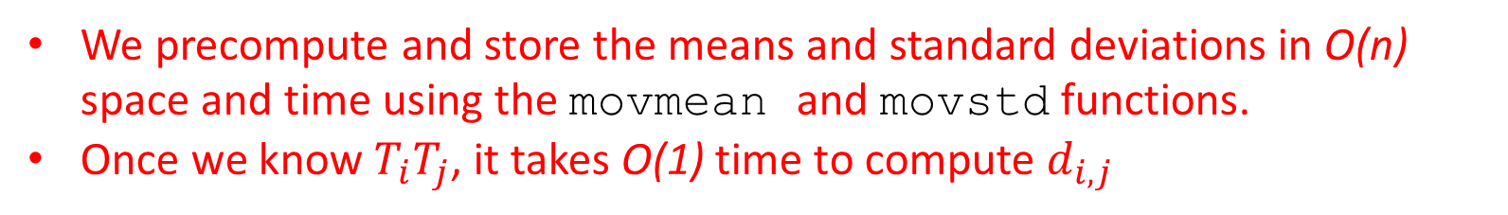
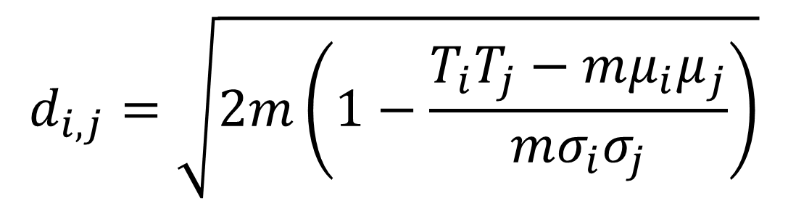
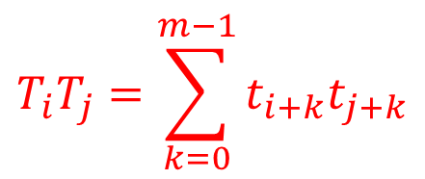
STOMP: Scalable Time series Ordered Matrix Profile
We have an O(n²) time, O(n) space algorithm called STOMP to evaluate it.
Recall our working formula:
$$T_{i}T_{j}=\sum_{k=0}^{m−1}{t_{i+k}t_{j+k}}$$
Dot product of the i^{th} window and the j^{th} window.
$$d_{i,j}=\sqrt{2m\left(1−\frac{T_{i}T_{j}−mμ_{i}μ_{j}}{mσ_{i}σ_{j}}\right)}$$
We precompute and store the means and standard deviations in O(n) space and time using the movmean and movstd functions.
Once we know$T_{i}T_{j}$, it takes O(1) time to compute $d_{i,j}$

Slide 24

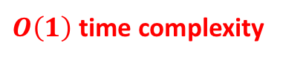


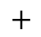

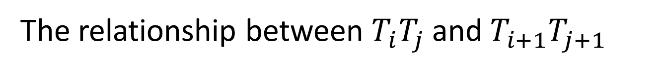
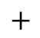


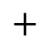
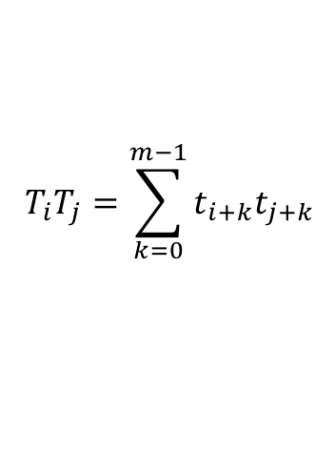
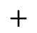
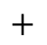

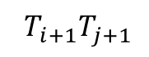
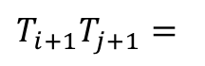


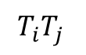
The relationship between $T_{i}T_{j}$and${ T}_{i+1}T_{j+1}$
$$T_{i}T_{j}$$
$${ T}_{i+1}T_{j+1}$$
… | $$t_{i}$$ | $$t_{i+1}$$ | $$t_{i+2}$$ | … | $$t_{i+m−1}$$ | $$t_{i+m}$$ | …
$$T_{i}T_{j}=\sum_{k=0}^{m−1}{t_{i+k}t_{j+k}}$$
…
$$×$$
$$+$$
$$×$$
$$+$$
$$×$$
$$+$$
$$+$$
$$×$$
… | $$t_{j}$$ | $$t_{j+1}$$ | $$t_{j+2}$$ | … | $$t_{j+m−1}$$ | $$t_{j+m}$$ | …
… | $$t_{i}$$ | $$t_{i+1}$$ | $$t_{i+2}$$ | … | $$t_{i+m−1}$$ | $$t_{i+m}$$ | …
$T_{i+1}T_{j+1}=$
$$×$$
$$+$$
$$×$$
$$+$$
$$+$$
$$×$$
$$+$$
$$×$$
… | $$t_{j}$$ | $$t_{j+1}$$ | $$t_{j+2}$$ | … | $$t_{j+m−1}$$ | $$t_{j+m}$$ | …
$$T_{i+1}T_{j+1}\text{= }T_{i}T_{j}−t_{i}t_{j}+t_{i+m}t_{j+m}$$
$O\left(1\right)$ time complexity

Slide 25

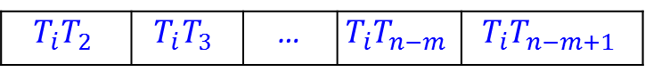
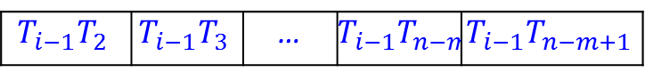
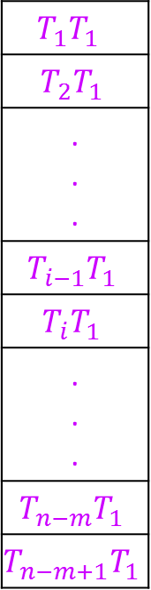
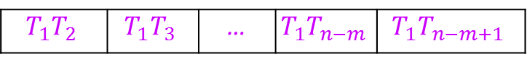
STOMP Algorithm: Computing the i^{th} Row
All means and standard deviations are precomputed. This costs linear time and space.
The first column and row of the matrix are identical and pre-computed by MASS.
We iterate through the rows. The previous row is maintained as a local array to feed dot products.
The dot products are converted to distance values and compared against the current best in the profile.
$$μ_{1}$$ | $$μ_{2}$$ | $$μ_{3}$$ | … | $$μ_{n−m+1}$$
$$σ_{1}$$ | $$σ_{2}$$ | $$σ_{3}$$ | … | $$σ_{n−m+1}$$
$$T_{1}T_{1}$$
$$T_{2}T_{1}$$
. . .
$$T_{i−1}T_{1}$$
$$T_{i}T_{1}$$
. . .
$$T_{n−m}T_{1}$$
$$T_{n−m+1}T_{1}$$
$$T_{1}T_{2}$$ | $$T_{1}T_{3}$$ | … | $$T_{1}T_{n−m}$$ | $$T_{1}T_{n−m+1}$$
Precomputed Arrays
$$T_{i−1}T_{2}$$ | $$T_{i−1}T_{3}$$ | … | $$T_{i−1}T_{n−m}$$ | $$T_{i−1}T_{n−m+1}$$
$$T_{i}T_{2}$$ | $$T_{i}T_{3}$$ | … | $$T_{i}T_{n−m}$$ | $$T_{i}T_{n−m+1}$$
Rolling Arrays
Update if Smaller
Output Arrays
P₁ | P₂ | P₃ | … | P_{n-m+1}
I₁ | I₂ | I₃ | … | I_{n-m+1}

Slide 26
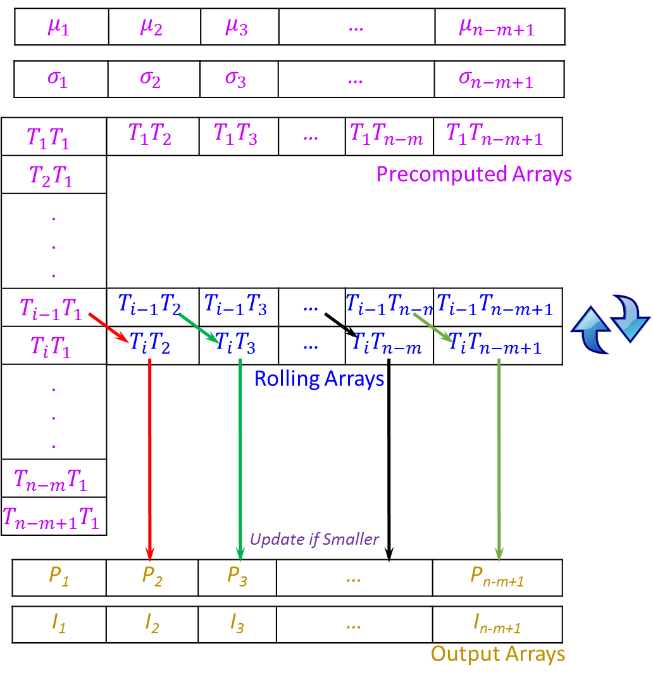
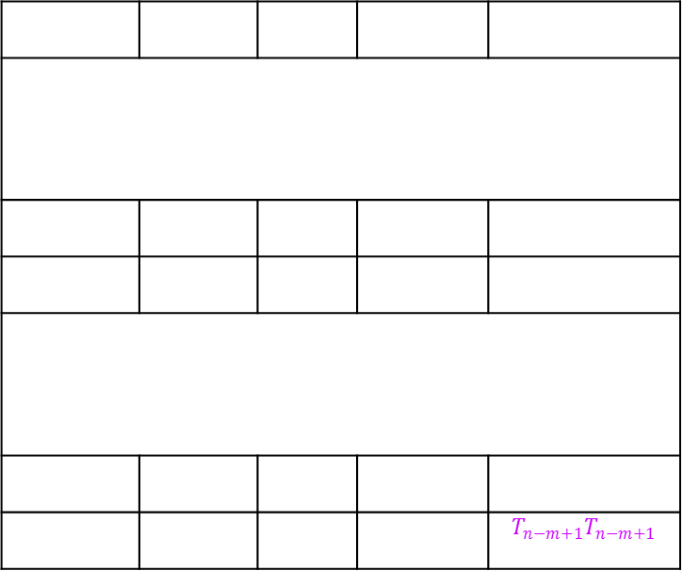
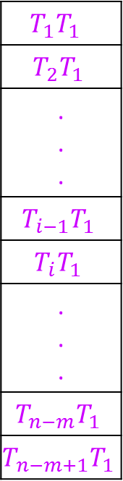
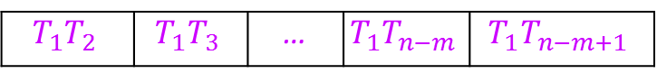
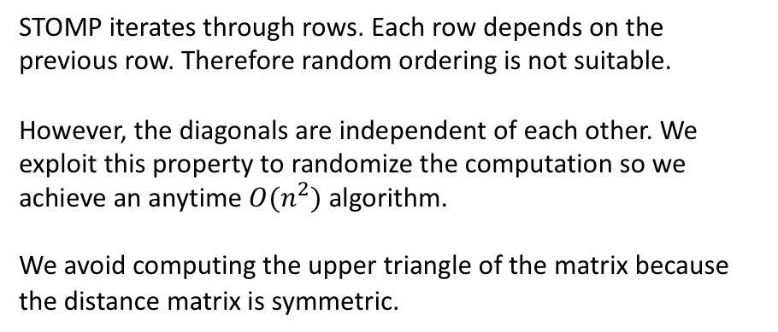
SCRIMP: Scalable Column Independent Matrix Profile
Precomputed Arrays
$$μ_{1}$$ | $$μ_{2}$$ | $$μ_{3}$$ | … | $$μ_{n−m+1}$$
$$σ_{1}$$ | $$σ_{2}$$ | $$σ_{3}$$ | … | $$σ_{n−m+1}$$
$$T_{1}T_{1}$$
$$T_{2}T_{1}$$
. . .
$$T_{i−1}T_{1}$$
$$T_{i}T_{1}$$
. . .
$$T_{n−m}T_{1}$$
$$T_{n−m+1}T_{1}$$
$$T_{1}T_{2}$$ | $$T_{1}T_{3}$$ | … | $$T_{1}T_{n−m}$$ | $$T_{1}T_{n−m+1}$$
 |  |  |  | $$T_{n−m+1}T_{n−m+1}$$
STOMP iterates through rows. Each row depends on the previous row. Therefore random ordering is not suitable.
However, the diagonals are independent of each other. We exploit this property to randomize the computation so we achieve an anytime $O(n^{2})$ algorithm.
We avoid computing the upper triangle of the matrix because the distance matrix is symmetric.
P₁ | P₂ | P₃ | … | P_{n-m+1}
Output Arrays
I₁ | I₂ | I₃ | … | I_{n-m+1}

Slide 27
Optimizations
The previous slides show the basic ideas involved in computing the matrix profile in an efficient manner
There are also many optimizations that can be made to produce faster implementations (hours -> seconds on GPU).
Please come see my talk tomorrow if you want to learn more about this aspect of the work.

Slide 28
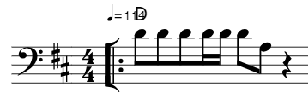
AB-joins
Is there any pattern that is common to these two time series? We can perform an AB-join to find out.
An AB-join matrix profile is just searching for matches from one time series inside another distinct time series, rather than the same time series.
ice
queen
0
0.5
1
1.5
2
2.5
4
10
The top join motif of 3 seconds shows a highly conserved pattern.
It is the famous bass line from Under Pressure by Queen
which was plagiarized by Vanilla Ice.
The top join motif
The concept for this example comes from Dr. Diego Furtado Silva.

Slide 29
Summary
The matrix profile is a simple, versatile tool applicable to many time series domains and makes many time series data mining tasks easy.
Motif discovery, anomaly detection, classification, clustering, semantic segmentation, and many more are possible.
The matrix profile can be computed very efficiently.
The matrix profile is data agnostic.
For more detailed information please visit:
https://www.cs.ucr.edu/~eamonn/MatrixProfile.html

Slide 30
Extra MP Slides

Slide 31

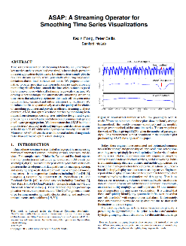
Taxi Example: Part I
Given a long time series, where should you examine carefully?
The problem is called “Attention Prioritization”, a group at Stanford is working on this [a].
However we think that the Matrix Profile can be used for this, “for free”.
Below is the data, the hourly average of the number of NYC taxi passengers over 75 days in Fall of 2014.
Lets compute the Matrix Profile for it, we choose a subsequence length corresponding to two days…. (next slide)
500
1000
1500
2000
2500
3000
3500
[a] http://futuredata.stanford.edu/ASAP/extended.pdf

Slide 32
Taxi Example: Part II
The highest value corresponds to Thanksgiving (the uniqueness of Thanksgiving was the only thing the Stanford Team noted)
We find a secondary peak around Nov 6th, what could it be? Daylight Saving Time! The clock going backwards one hour, gives an apparent doubling of taxi load.
We find a tertiary peak around Oct 13th, what could it be? Columbus Day! Columbus Day is largely ignored in much of America, but still a big deal in NY, with its large Italian American community.
500
1000
1500
2000
2500
3000
3500
0
500
1000
1500
2000
2500
3000
3500

Slide 33
Taxi Example: Part III
What about the lowest values? (the best motifs)
They are exactly seven days apart, suggesting that in this dataset, there might be a periodicity of seven days, in addition to the more obvious periodicity of one day.
500
1000
1500
2000
2500
3000
3500
0
500
1000
1500
2000
2500
3000
3500

Slide 34

Zebra Finch
(Zebra Finch Vocalizations in MFCC, 100 day old male)
1000
2000
3000
4000
5000
6000
7000
8000
Motif discovery can often surprise you.
While it is clear that this time series is not random, we did not expect the motifs to be so well conserved or repeated so many times. There is evidence of a vocabulary, and maybe even a grammar…
motif 1
motif 2
motif 3
0
2 seconds
200

Slide 35

Chimp DNA
Y-chromosome converted to time series
It is possible to convert DNA strings to real-valued time series, in a lossless fashion
T₁ = 0;
for i = 1 to length(chromosome)
if chromosome_{i} = A, then T_{i+1} = T_{i} + 2
if chromosome_{i} = G, then T_{i+1} = T_{i} + 1
if chromosome_{i} = C, then T_{i+1} = T_{i} - 1
if chromosome_{i} = T, then T_{i+1} = T_{i} - 2
end
Let us search the Chimp’s DNA for repeated structure, of length 60,000…
Pan troglodytes Y-chromosome
0
1,000,000
12,749,475 to 14,249,474 bp
622,725 to 2,122,724 bp
*“much of the Y (Chimp chromosome) consists of lengthy, highly similar repeat units, or ‘amplicons’”
Zoom-In
0
*J. Hughes et al., “Chimpanzee and human Y chromosomes are remarkably divergent in structure” Nature 463, (2010).
60,000

Slide 36



Music
While motifs usually point to chorus, discords point to bridges or solos
{instrumental bridge}
let it be, let it be, yeah let it be And there will be an answer, let it
Discord at 1m54
let it be, let it be, yeah let it be And there will be an answer, let it
60
45
Motifs at 3m9s and 3m23s
30
15
0
60
120
180
Time (s)

Slide 37



Summary
We could do this all day! We have applied the MP to hundreds of datasets.
It is worth reminding ourselves of the following:
The MP can find structure in taxi demand, seismology, DNA, power demand, heartbeats, music and bird vocalization data. However the MP does not “know” anything about this domains, it was not tweaked, tuned or adjusted in anyway.
This domain-agnostic nature of MP is a great strength, you typically get very good results “out-of-the-box” no matter what your domain.
The following is also worth stating again:
We spent time looking at the MP to gain confidence that it is doing something useful. However, most of the time, only a higher-level algorithm will look at the MP, with no human intervention or inspection (we will make that clearer in the following slides).

